Slide 1
Predicting Patient Length of Stay
in Hospital
(Group 2)
Sabrina Casas
Bhavya Arora Komali Challa
Gaurav Kumar
Elisha Shrestha
Olushola Soyoye

Slide 2
Introduction
•The Covid-19 Pandemic has spanned over 3 years. The healthcare system in the U.S. has been strained and has received special attention because of it.
• There’s need to improve the efficiency of healthcare management in a hospital and one critical parameter for this is to observe and predict patient length of stay (LOS).
•Hospitals can identify patients with high LOS risk (patients who will stay longer) at the time of admission.
•Treatment plan can be adjusted to reduce LOS and reduce the risk of staff/visitor infection.
•Also this information helps with practicalities such as planning space and bed allotment.

Slide 3
Motivation
To alleviate the strain on the healthcare system
On staff and resources
To Improve the efficiency of health care logistics
Reports claiming there is still a bed shortage

Slide 4
Data & Context
Dataset (Kaggle): Healthcare Analytics II.
Dataset size: 318,438 entries.
Aim: to analyze the LOS of patients to optimize resource allocation and improve hospital functioning.
17 predictor variables, 12 used variables used for predictive model.
Target variable: ‘Stay’ – LOS of patients is classified into 11 different classes, ranging from 0-10 days to more than 100 days.

Slide 5
Data preprocessing
Column | Description
case_id | Case_ID registered in Hospital
Hospital_code | Unique code for the Hospital
Hospital_type_code | Unique code for the type of Hospital
City_Code_Hospital | City Code of the Hospital
Hospital_region_code | Region Code of the Hospital
Available Extra Rooms in Hospital | Number of Extra rooms available in the Hospital
Department | Department overlooking the case
Ward_Type | Code for the Ward type
Ward_Facility_Code | Code for the Ward Facility
Bed_Grade | Condition of Bed in the Ward
Column | Description
patientid | Unique Patient Id
City_Code_Patient | City Code for the patient
Type of Admission | Admission Type registered by the Hospital
Severity of Illness | Severity of the illness recorded at the time of admission
Visitors with Patient | Number of Visitors with the patient
Age | Age of the patient
Admission_Deposit | Deposit at the Admission Time
Stay | Stay Days by the patient
428 duplicate entries removed.
Final dataset: 318,010 entries.

Slide 6
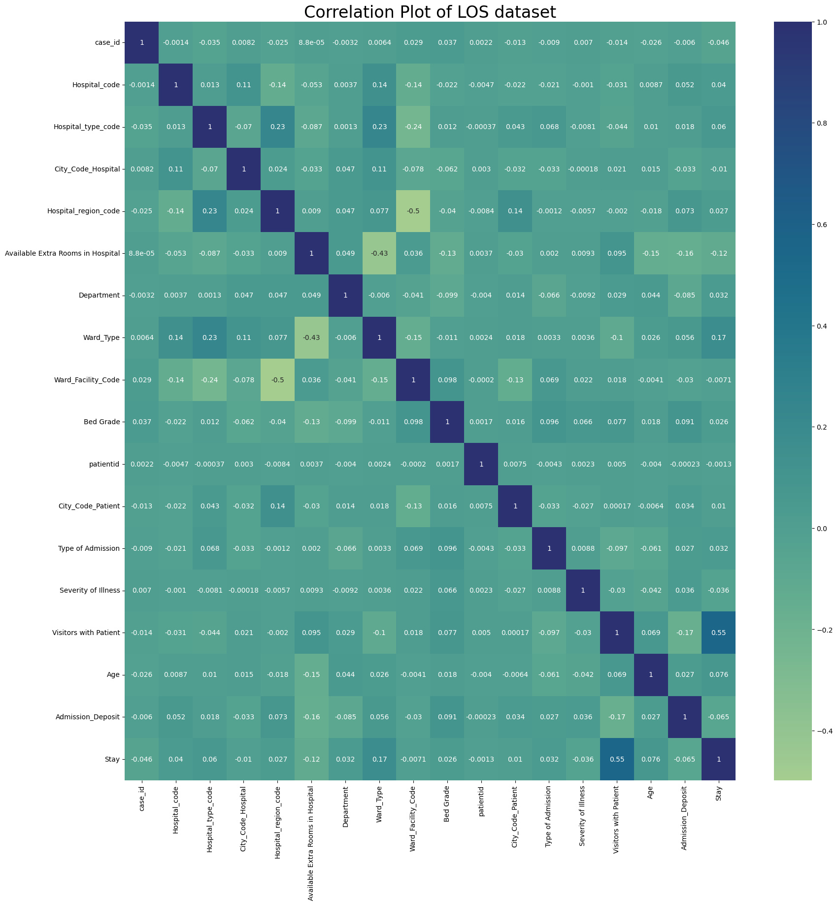
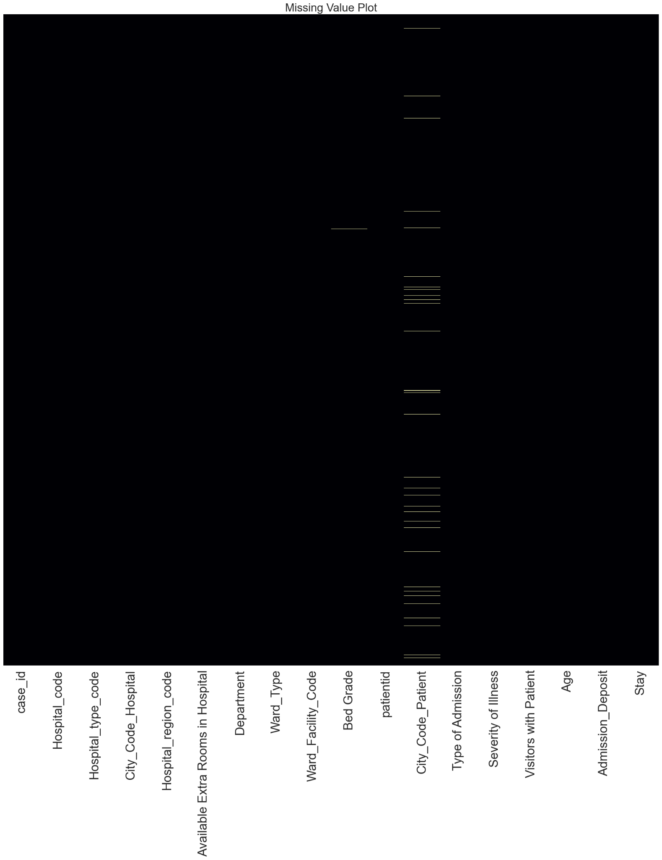

Slide 7
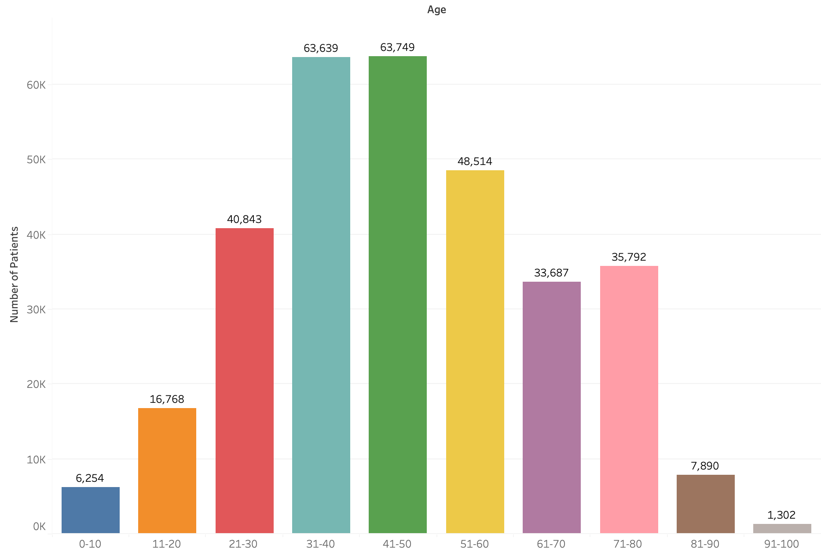
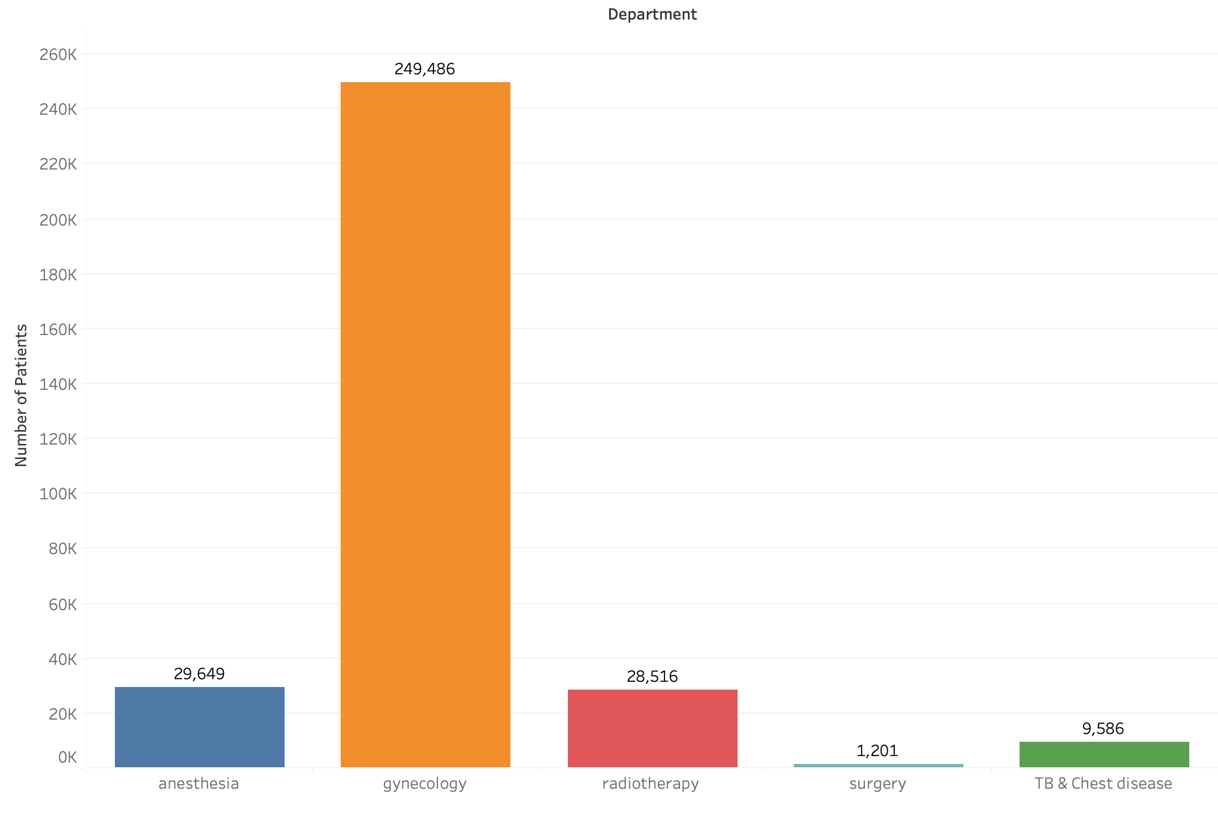
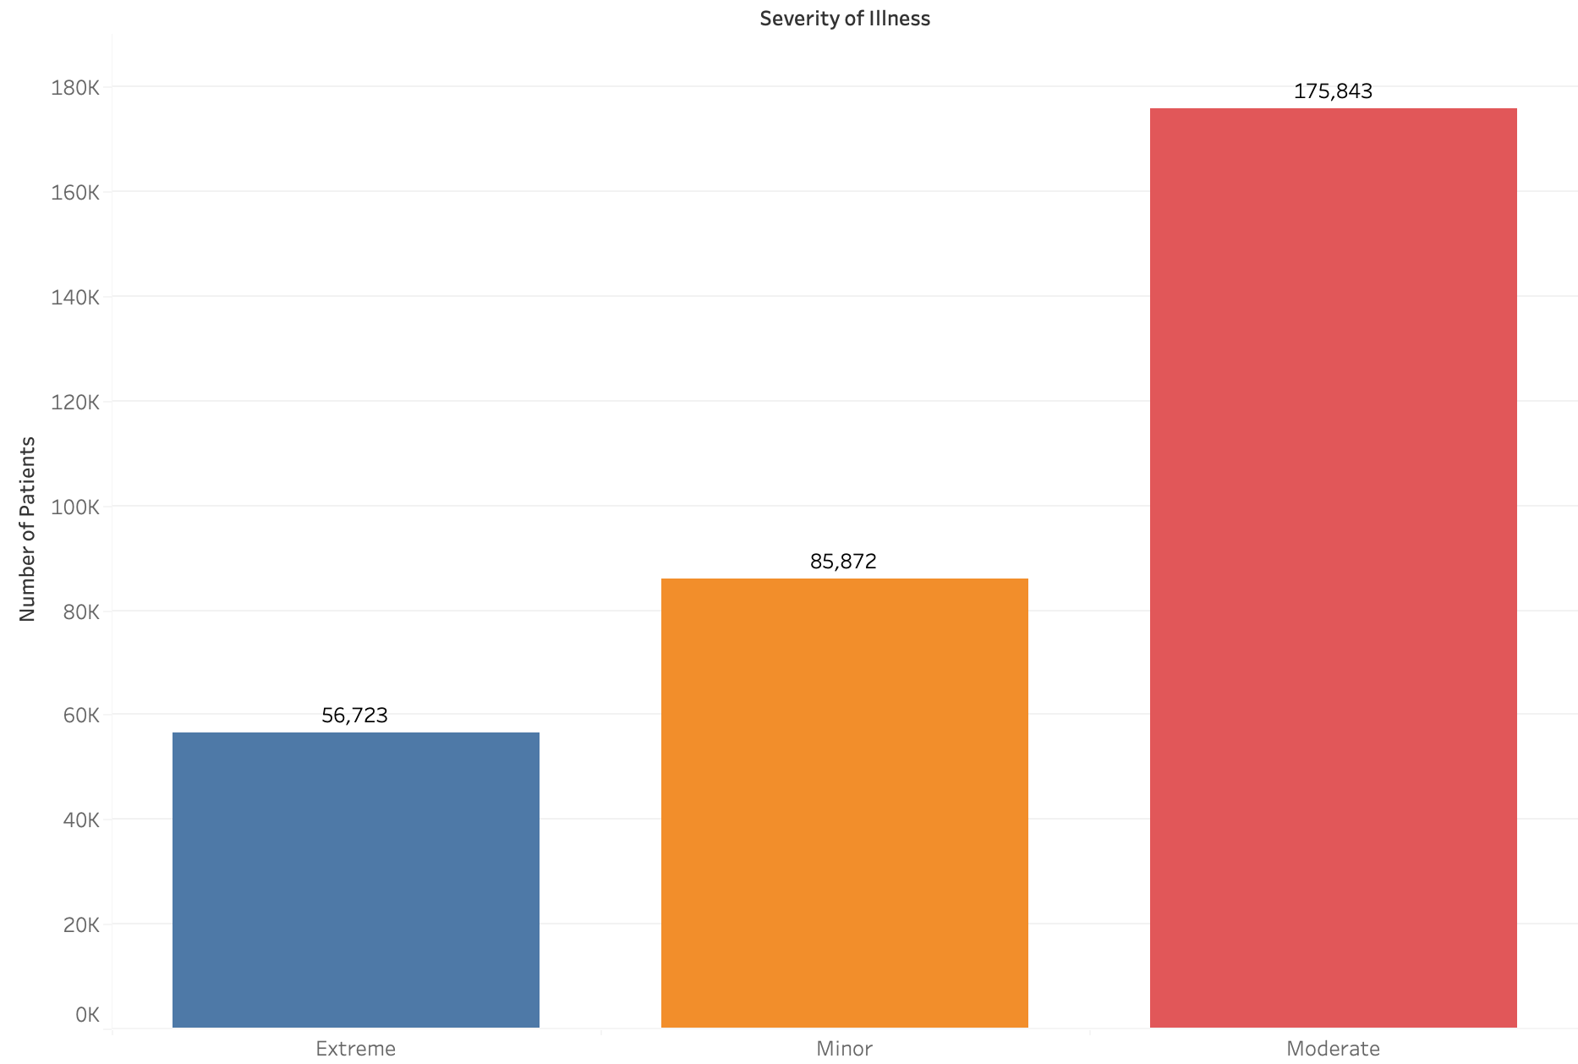
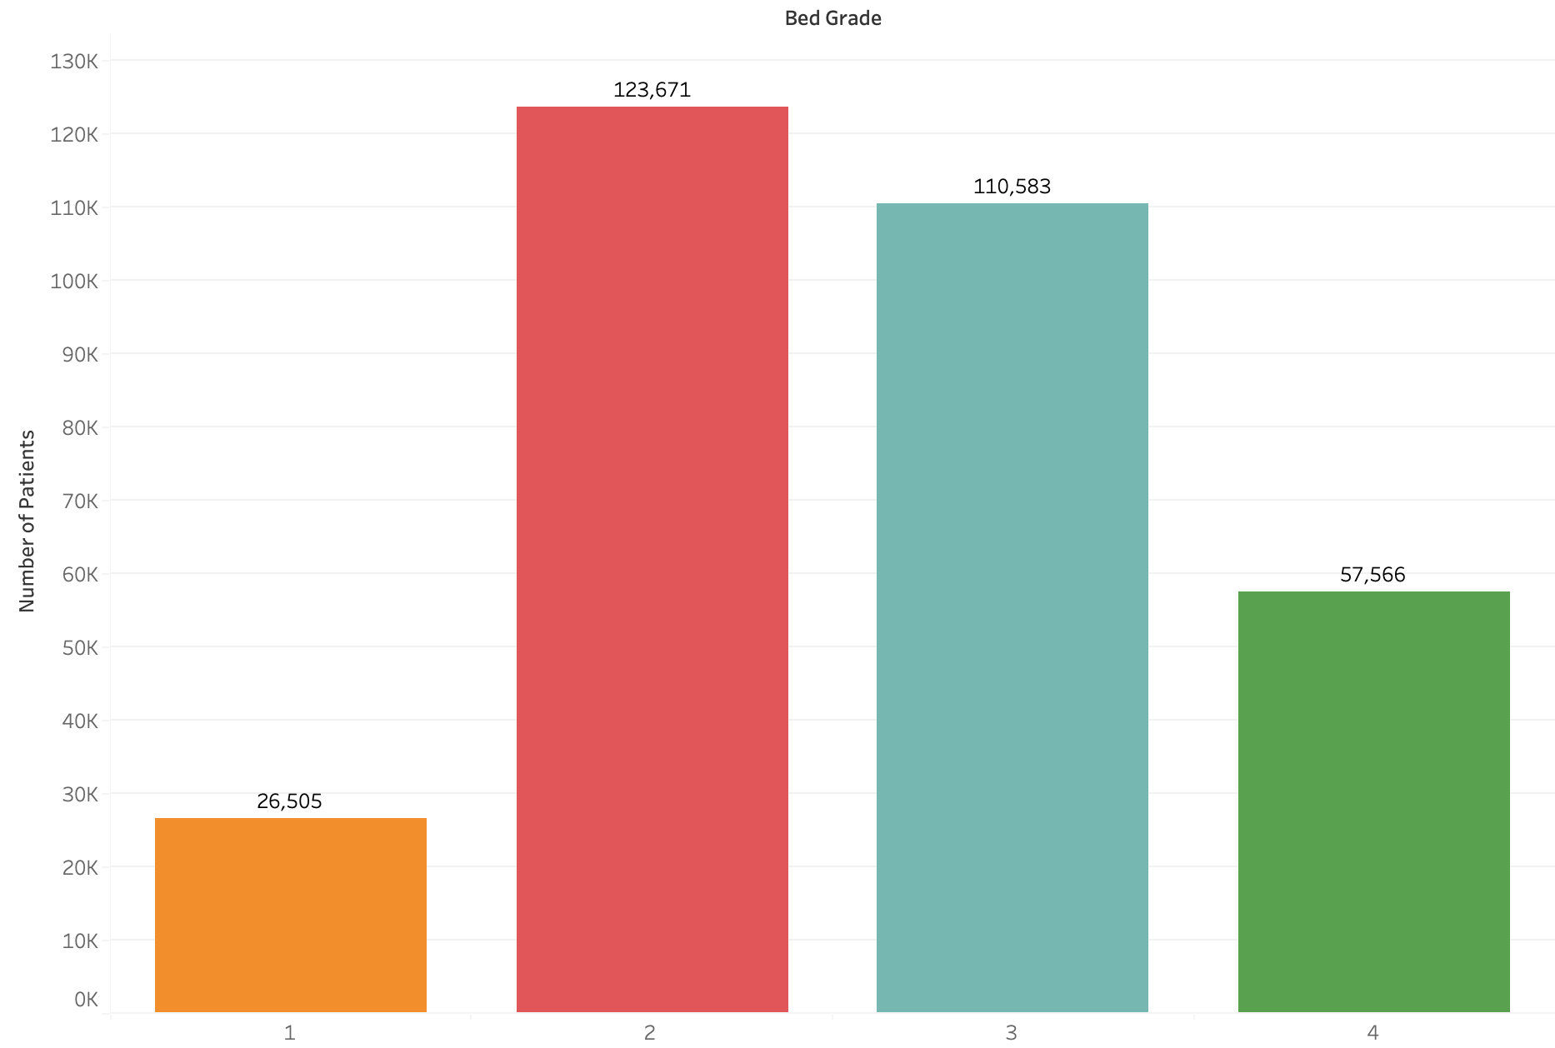

Slide 8
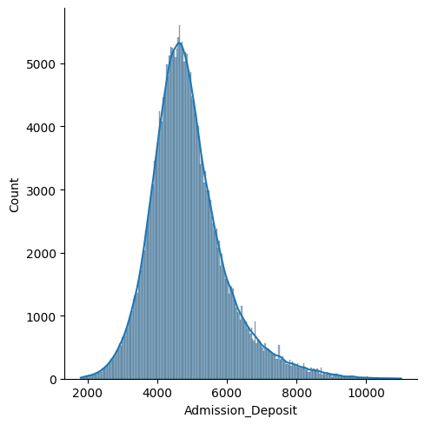
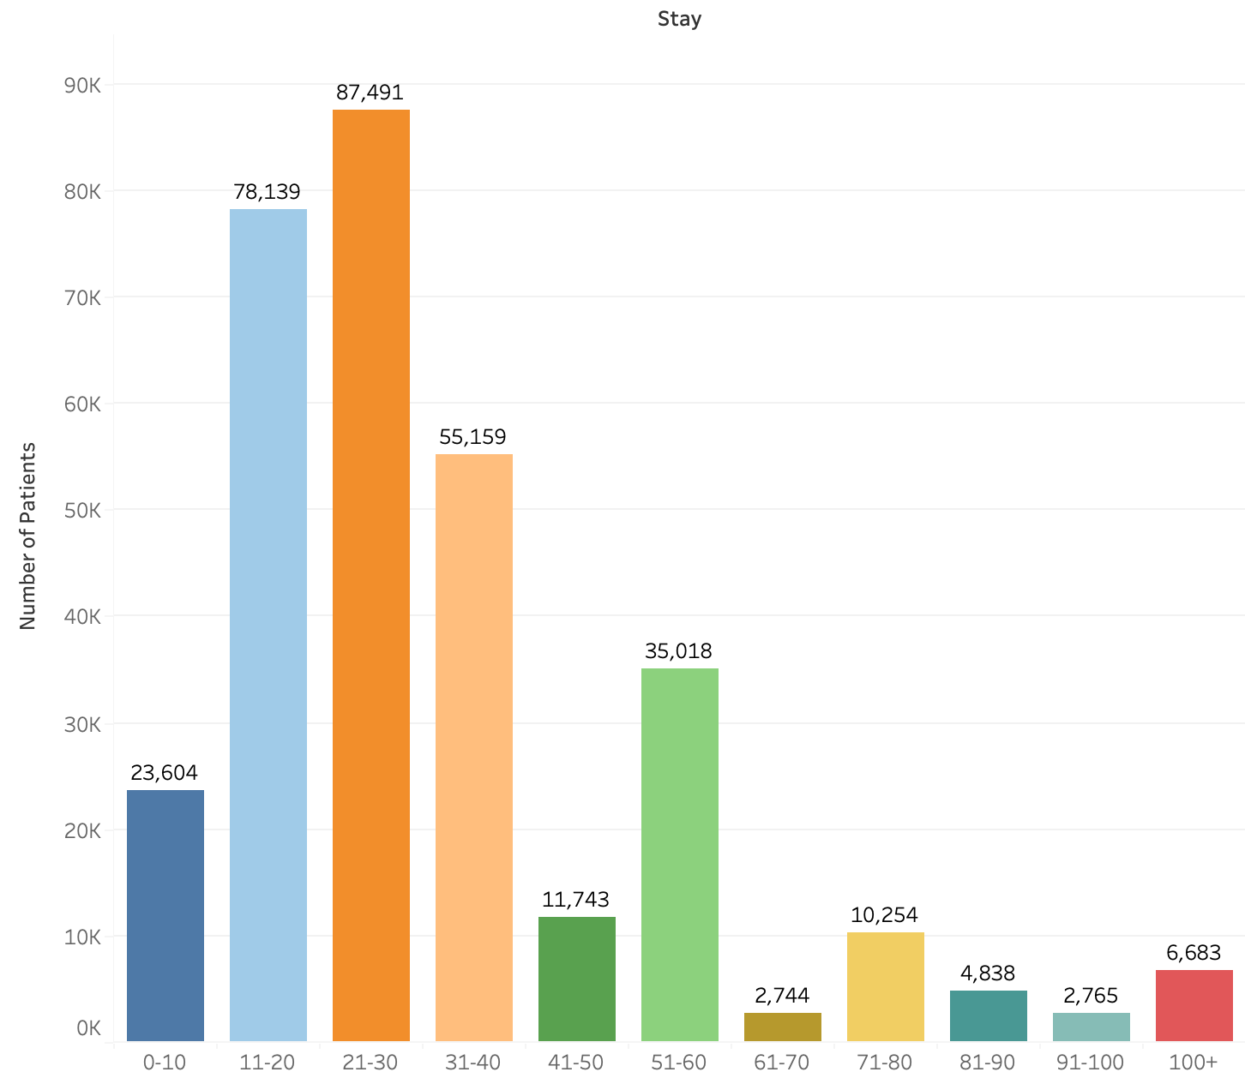

Slide 9
Model | Accuracy
RandomForestClassifier | 33.83
KNeighborsClassifier | 29.53
LogisticRegression | 36.08
DecisionTreeClassifier | 28.56
GaussianNB | 29.79
XGBoost | 41.32

Slide 10
Potential Reasons For Low Classification Accuracy
Insufficient number of trees in the forest.
Overfitting due to excessive depth of the decision tree.
Lack of regularization to prevent overfitting.
Insufficient number of boosting rounds.
Imbalanced class distribution in the training data.
Incorrect hyperparameter tuning.

Slide 11
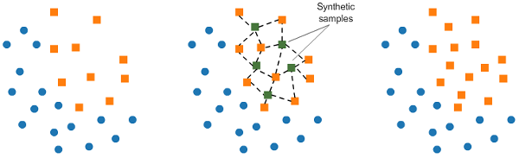
SMOTE
Synthetic Minority Oversampling TEchnique
This technique generates synthetic data for the minority class. SMOTE works by randomly picking a point from the minority class and computing the k-nearest neighbors for this point. The synthetic points are added between the chosen point and its neighbors.

Slide 12
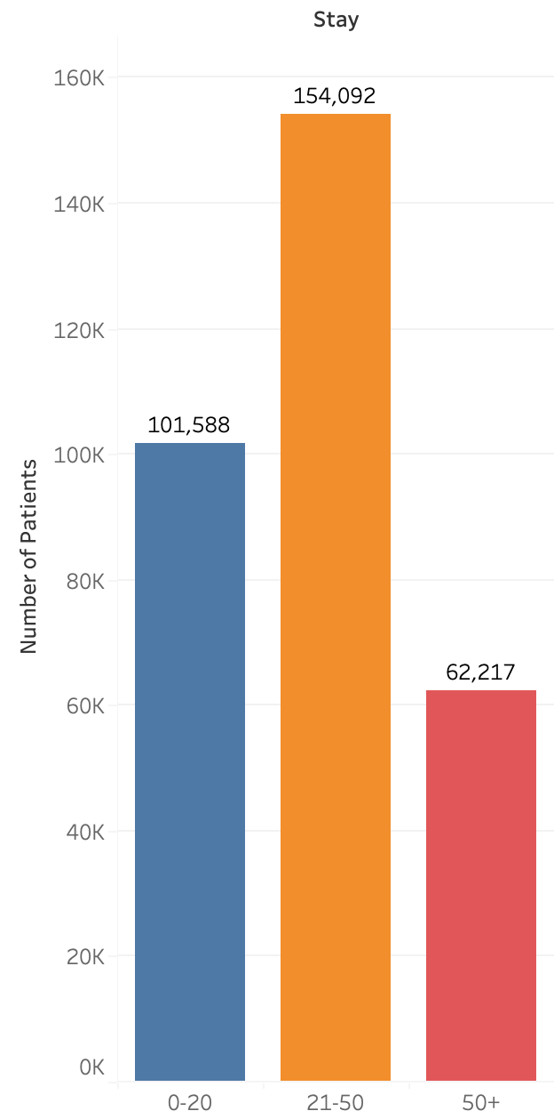
Recategorization
This technique involves dividing the target class into distinct categories based on the duration of stay.
We partition the stay duration into three categories: 0-20 days as 0; 21-60 days as 1 ; and 61-100+ days as 2.

Slide 13
Results
 | Initial | SMOTE | Recategorization | Recategorization + SMOTE
RandomForestClassifier | 33.83 | 64.61 | 56.09 | 66.25
KNeighborsClassifier | 29.53 | 51.81 | 54.84 | 66.29
LogisticRegression | 36.08 | 34.29 | 56.85 | 58.87
DecisionTreeClassifier | 28.56 | 63.02 | 51.3 | 61.46
GaussianNB | 29.79 | 18.56 | 29.97 | 53.36
XGBoost | 41.32 | 45.04 | 60.73 | 68.44

Slide 14
Challenges & Future Work
Hyperparameter tuning
Feature Selection
Source data from other health departments

Slide 15
Resources
The virus threat is easing, but US hospitals are still as full as ever | CNN
Health Care Analytics - 2 | Kaggle

